Slide 1


Project Title
On
“Library Management System”
Course Code : CSE-0317
Course Title : Software Engineering
Submitted By
Md.Arif Hossen
ID-UG02-50-19-005
Sumaiya Rashmi
ID-UG02-51-19-012
Submitted To
Trina Saha Mou,
Lecturer,
Department of
Computer Science And Engineering,
State University of Bangladesh.
Date of Submission : 11 April 2022

Slide 2
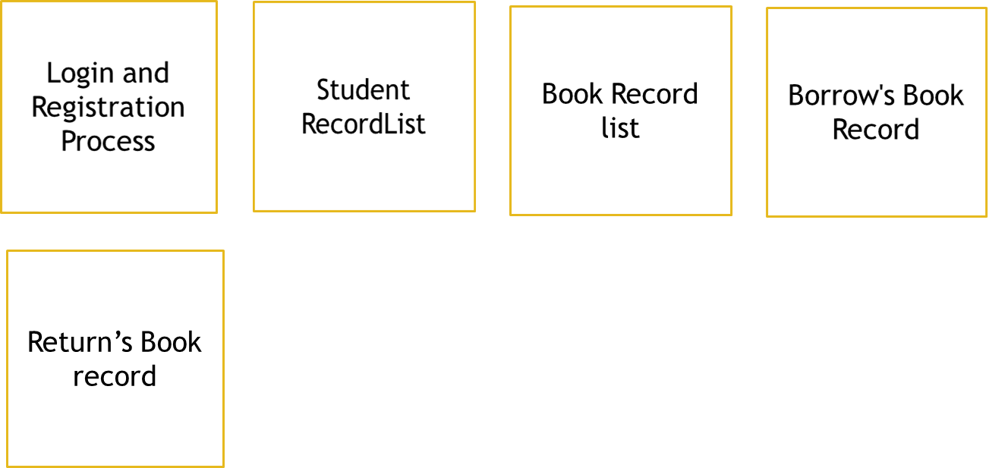
Project Tools
JDK( Java Development Kit)
NetBeans
Computer
Java language
Java swing
MySQL Database (Wamp Server).
Design
Statistics
Of LMS
About Developers
Help
Exit

Slide 3
Advantages
Easy to use
Cost effective
Time saves and reduce overhead
Record support
Help to Reduce Liberian works

Slide 4
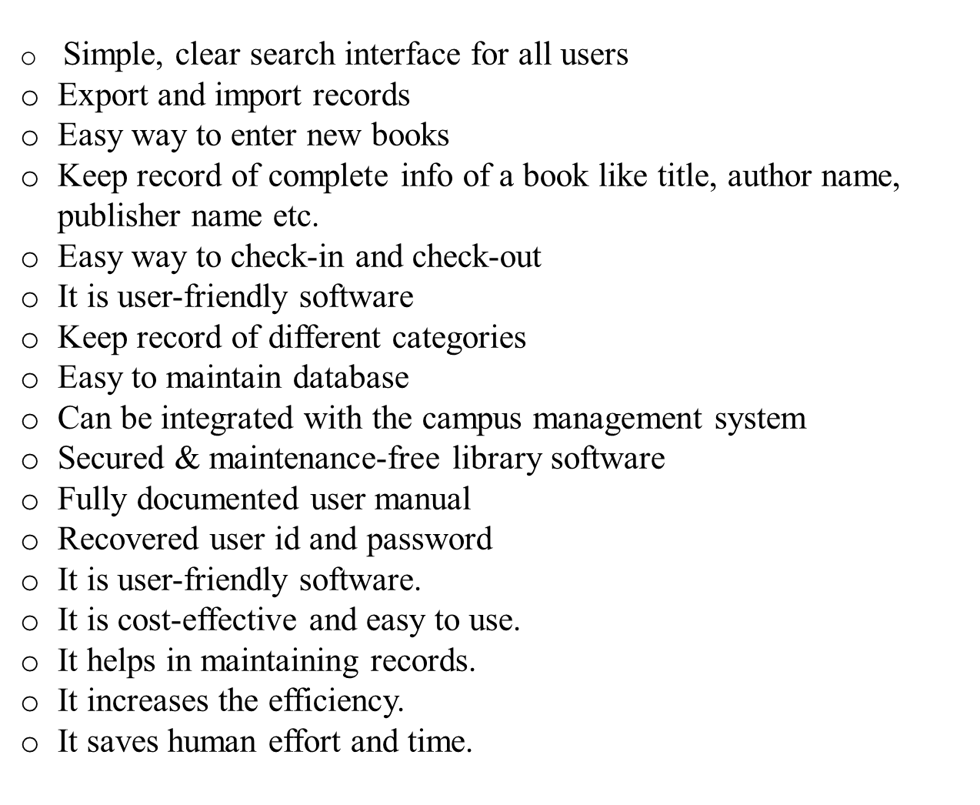

Slide 5
Conclusion
The Internet has become a major resource in modern life, thus library management system has gained significance not only from the management staff but also from the student’s point of view. For the management, library system generates new books opportunities and for the student, it makes comparative selecting possible.
Though we are making an offline version. If we able to make online version and also a student (member) viewing section through creating account on this system.

